Slide 1
ist 263
CSS

Slide 2
Agenda
Project Notes
Wireframes
CSS

Slide 3
Project Notes

Slide 4
Project Folder and Point of No Return
Make project folder in GitHub Repository
Point of No Return Project Milestone 4

Slide 5
Wireframes

Slide 6
What is a wireframe?
Allows us to design basic layout of a website without thinking about design.
They help us focus on user experience.

Slide 7
Why do you need wireframes?
Takes focus away from the design, colors, fonts and just talks about location of content on the page
Helps us focus on user experience
Shows the weight of different areas of the website

Slide 8
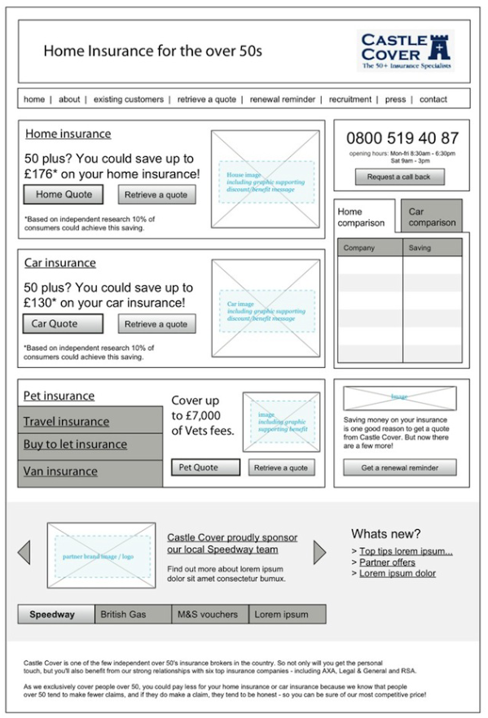
Wireframe examples

Slide 9
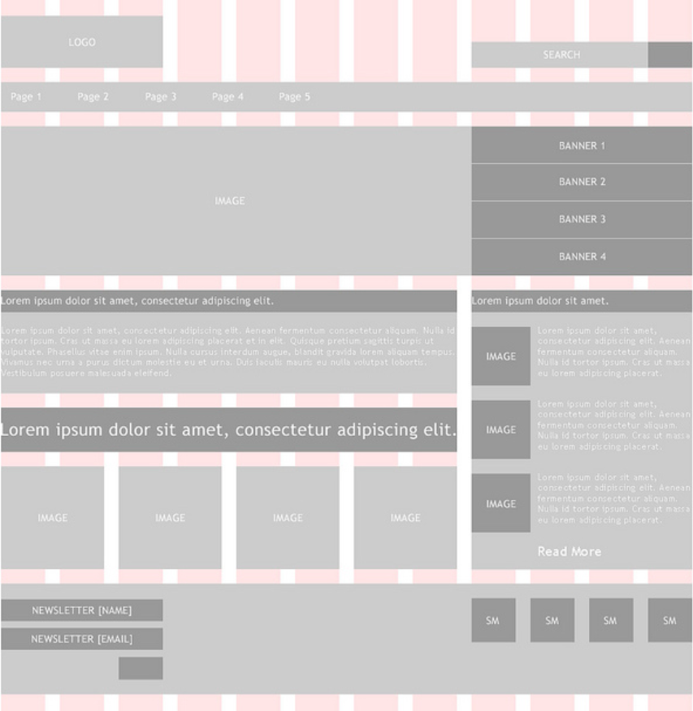
Wireframe examples

Slide 10
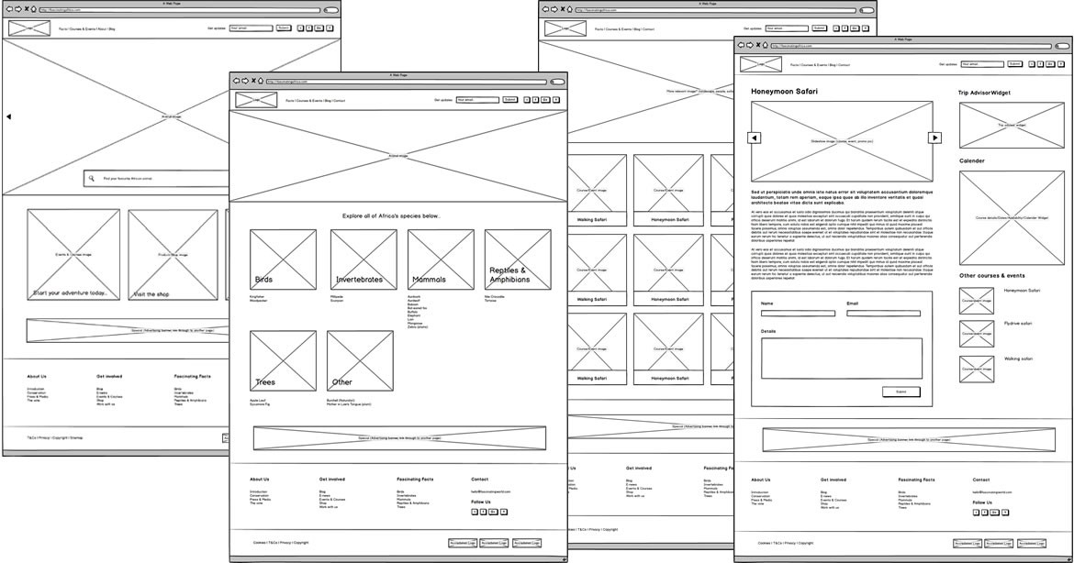
Wireframe Examples

Slide 11
Wireframe Demo in MockFlow https://mockflow.com/
Navigation
Large image
Welcome text
Feature area
Footer

Slide 12
What is CSS?

Slide 13
Standard for defining presentation of HTML documents.

Slide 14
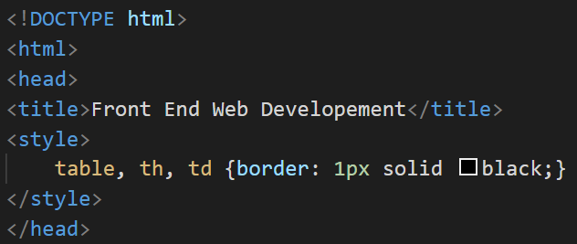
Preview from Unit 4

Slide 15

Writing a CSS Rule

Slide 16
External, embedded or Inline

Slide 17

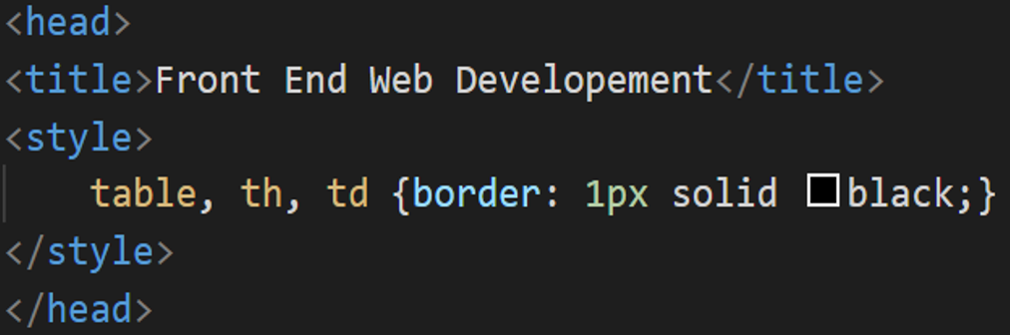
Ways to Add CSS
Type | Example | Notes
Linked or External |  | Style sheet is a separate file with .css file extension. You can use this to style all site pages.
Embedded or Internal |  | Styles are at the top of your .html file inside the head tag.
Inline |  | Styles are in attributes on your elements inside the body tag. This is frowned upon.

Slide 18
Units of measure

Slide 19
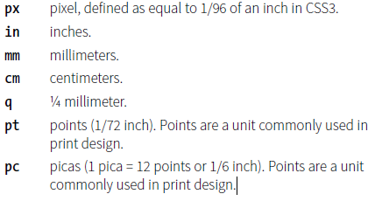
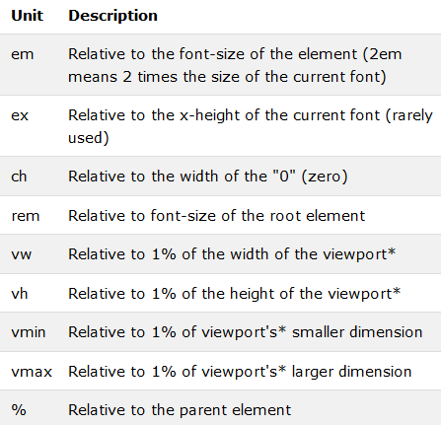
Absolute vs Relative
Absolute
Relative
Have predefined meanings or real-world equivalents. They are not appropriate for web pages.
Relative units are based on the size of something else, such as the default text size.

Slide 20
Inheritance and the DOM

Slide 21
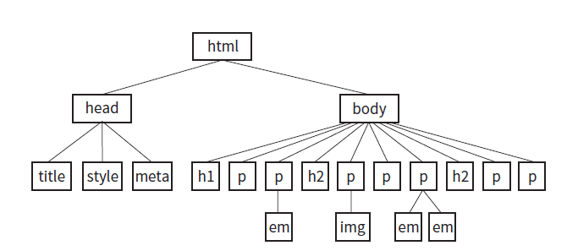
Document Object Model

Slide 22
Formatting text

Slide 23
Fonts
Font Face
Size
Weight

Slide 24
Text Color

Slide 25
Text Decoration

Slide 26
CSS Review: Font and Text Properties
CSS REVIEW: FONT AND TEXT PROPERTIES
In this chapter, we covered the properties used to format text elements. Here is a summary in alphabetical order.
Property | Description
color | Specifies the foreground color (text and borders) for an element
direction | Indicates whether the text reads left-to-right or right- to-left
font | A shorthand property that combines font properties
font-family | Specifies a typeface or generic font family
font-feature-settings | Allows access to lesser-used OpenType features
font-kerning | Controls how browsers implement kerning data (space between characters)
font-language-override | Controls use of language-specific glyphs
font-size | Specifies the size of the font
font-size-adjust | Matches the x-height of a fallback font with the speci- fied font
font-stretch | Selects a condensed, normal, or extended font
font-style | Specifies italic or oblique fonts
font-synthesis | Controls whether a browser may simulate bold or italic fonts
font-variant | Specifies a small-caps font
font-variant-alternates | Selects alternate versions of character glyphs
font-variant-caps | Selects small caps and similar alternates when available
font-variant-east-asian | Selects alternate glyphs in Chinese, Japanese, and Korean
font-variant-ligatures | Selects ligatures for certain letter pairs when available
font-variant-numeric | Selects alternate number glyphs
font-variant-position | Selects subscript or superscript character glyphs
font-weight | Specifies the boldness of the font
hanging-punctuation | Indicates whether the punctuation may hang outside the content box
hyphens | Controls how text is hyphenated
letter-spacing | Inserts space between letters
line-break | Describes rules for breaking lines
line-height | Indicates the distance between baselines of neighbor- ing text lines
12. Formatting Text 301

Slide 27
CSS Review: Font and Text Properties
Property | Description
list-style-image | Specifies an image to be used as a list marker
list-style-position | Puts a list marker inside or outside the content area
list-style-type | Selects the marker type for list items
overflow-wrap | Specifies whether the browser can break lines within words to prevent overflow
tab-size | Specifies the length of a tab character
text-align | Indicates the horizontal alignment of text
text-align-last | Specifies how the last line in justified text is aligned
text-decoration | Specifies underlines, overlines, and lines through
text-indent | Specifies the amount of indentation of the first line in a block
text-justify | Denotes how space is distributed in justified text
text-shadow | Adds a drop shadow under the text
text-transform | Changes the capitalization of text when it displays
unicode-bidi | Works with Unicode bidirectional algorithms
vertical-align | Adjusts the vertical position of inline elements relative to the baseline
white-space | Specifies how whitespace in the source is displayed
word-break | Specifies whether to break lines within words
word-spacing | Inserts space between words
word-wrap | Indicates whether the browser can break lines within words to prevent overflow (same as overflow-wrap)
302 Part III. CSS for Presentation

Slide 28
Selectors

Slide 29

Group Selectors

Slide 30
Descendant Selectors
p a {color: orange}

Slide 31
id selectors
#myheading {color: pink;}

Slide 32
class selectors
.myclass {color: grey;}

Slide 33
Selectors at a Glance
Selector | IN HTML | IN CSS
Class | <p class=“myclass”> | .myclass {color: green;}
ID | <p id=“myid”> | #myid {color: green;}
Descendant | <p><a href=“http://www.syr.edu”></a></p> | p a {color: green;}
Element | <p> | p {color: green;}
Grouped |  | p, td, a {color: green}

